Slide 1
Patron Driven Acquisition (PDA)
Demand Driven Acquisition (DDA)
Yoel Kortick
Senior Librarian
Alma Product Management

Slide 2
Copyright Statement
All of the information and material inclusive of text, images, logos, product names is either the property of, or used with permission by Ex Libris Ltd. The information may not be distributed, modified, displayed, reproduced – in whole or in part – without the prior written permission of Ex Libris Ltd.
TRADEMARKS
Ex Libris, the Ex Libris logo, Aleph, Alma, SFX, SFXIT, MetaLib, DigiTool, Verde, Primo, Voyager, MetaSearch, MetaIndex and other Ex Libris products and services referenced herein are trademarks of Ex Libris, and may be registered in certain jurisdictions. All other product names, company names, marks and logos referenced may be trademarks of their respective owners.
DISCLAIMER
The information contained in this document is compiled from various sources and provided on an "AS IS" basis for general information purposes only without any representations, conditions or warranties whether express or implied, including any implied warranties of satisfactory quality, completeness, accuracy or fitness for a particular purpose.
Ex Libris, its subsidiaries and related corporations ("Ex Libris Group") disclaim any and all liability for all use of this information, including losses, damages, claims or expenses any person may incur as a result of the use of this information, even if advised of the possibility of such loss or damage.
© Ex Libris Ltd., 2011

Slide 3
Agenda
Introduction and overview
Create a new PDA entry
Manage PDA Profiles - Repository
Manage PDA Profiles - New Order
Remove non-ordered records

Slide 4
Introduction and overview
In this presentation we will give an overview of PDA and then perform a typical workflow:
Create a PDA profile
Receive a file from a vendor with two electronic portfolios (normally of course there would be many more than two) and upload the file via the PDA import profile
Assume one record was clicked by end users in discovery and ordered from vendor
Assume the other record was never clicked by end user and thus never ordered
Receive EOD file from vendor with the ordered record and upload the file via the PDA import profile. We will see the new order
At the end of the PDA period we will cleanup to remove the record which was never clicked (and thus never ordered)
We will not cover here every option related to PDA.
For additional information see the On Line Help

Slide 5

Introduction and overview
Patron Driven Acquisition (PDA) is also known as ‘Demand Driven Acquisition (DDA)’
In Alma it represents an agreement between the institution and a vendor.
The agreement primarily is for a vendor to provide e-resources to the institution.
http://scienceinpoland.pap.pl/Data/Thumbs/_plugins/information/396553/MTAyNHg3Njg,14325307_14222365.jpg

Slide 6



Introduction and overview
The E-resources which are provided by the vendor are imported as a repository file.
The records are then published by the library and subsequently appear in the discovery interface (Primo) to be accessed by patrons.

Slide 7
Introduction and overview
Access to the e-resources in the discovery interface is monitored by the vendor
When a predefined threshold is exceeded, the item is considered as if it is purchased and is sent as part of an EOD (Embedded Order Data – a file of orders) to Alma.
The orders are marked as PDA and are loaded into Alma, and the vendor then sends the relevant invoices.
At the end of the defined PDA period, PDA resources that were not purchased can be removed from Alma by the institution.

Slide 8
Introduction and overview
The steps of the process are as follows
Create a PDA on the PDA Details page and activate it.
Manage profiles for the PDA
Receive a file from the vendor, import it to Alma. Electronic inventory is created and published to the discovery interface.
The vendor sends an embedded order data (EOD) file to Alma (containing orders for the purchased resources). The orders are loaded into Alma
The vendor sends invoices for the orders
At the end of the defined PDA period, PDA resources that were not purchased can be removed from Alma.

Slide 9
Agenda
Introduction and overview
Create a new PDA entry
Manage PDA Profiles - Repository
Manage PDA Profiles - New Order
Remove non-ordered records

Slide 10
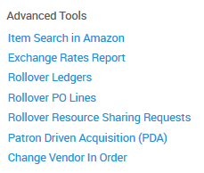
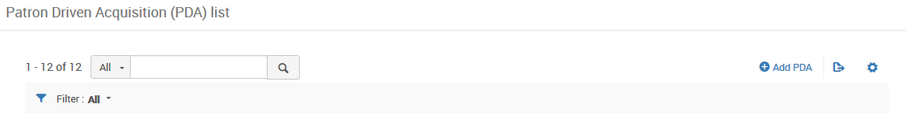
Create a new PDA entry
Click the ‘Patron Driven Acquisition (PDA)’ link under Acquisitions > Advanced Tools > Patron Driven Acquisition (PDA)
Click Add PDA.

Slide 11
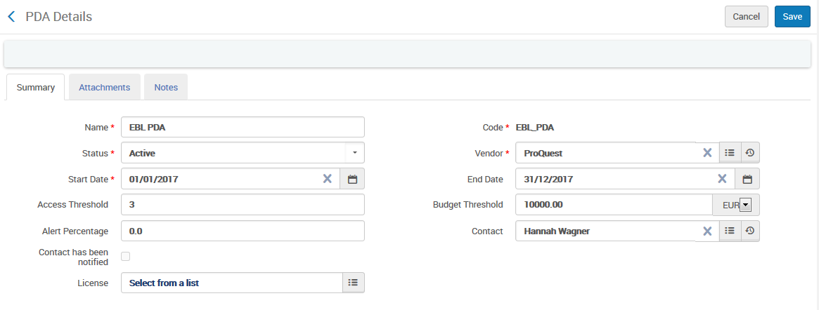
Create a new PDA entry
The PDA page opens

Slide 12
Create a new PDA entry
For a full description of all fields in the PDA Details screen see the OLH. Here are the three “specially significant’ fields:
Access threshold = The number of access requests which will be made to trigger the purchase. On the PDA details page it is informative only. The vendor checks the value “from his end”
Budget threshold = The maximum amount of money that the institution is willing to pay for e-resources after the Access threshold has been reached. On the PDA details page it is informative only.
Alert Percentage = When the PDA usage exceeds the alert percentage of the budget threshold, an email notification is sent to the contact person. This occurs after the ‘PDA- Alert PDA Reached Threshold’ job runs. (The PDA- Alert PDA Reached Threshold job is set to automatically run once per day. After importing an EOD file, the job is run to determine whether an email notification is to be sent.

Slide 13
Agenda
Introduction and overview
Create a new PDA entry
Manage PDA Profiles - Repository
Manage PDA Profiles - New Order
Remove non-ordered records

Slide 14
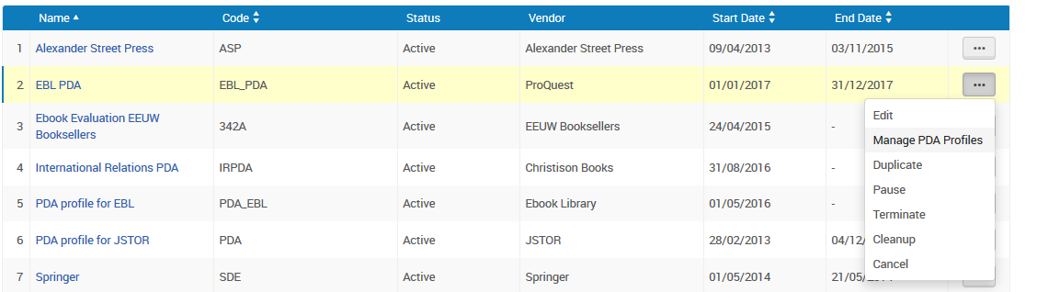
Manage PDA Profiles - Repository
The PDA profiles are the import profiles that do the actual loading of the electronic resources
To manage the PDA profiles choose ‘manage PDA Profiles’ from the Patron Driven Acquisition (PDA) List page

Slide 15
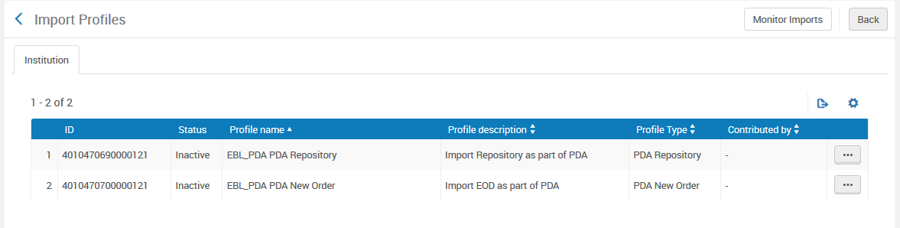
Manage PDA Profiles - Repository
The PDA import profiles which are associated with the PDA profiles will appear.
There will be a profile for type ‘PDA Repository’ and another for type ‘PDA New Order’

Slide 16
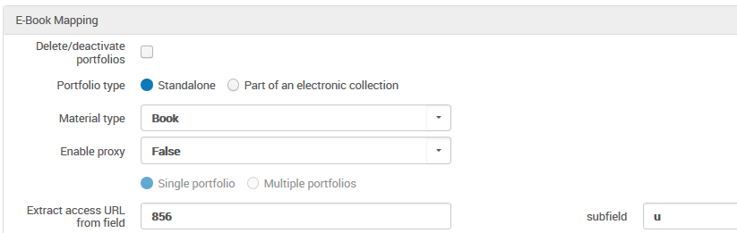
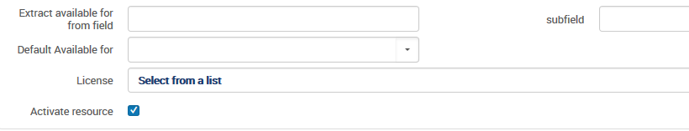
Manage PDA Profiles - Repository
In this import profile of type ‘PDA Repository’ we state to take the URL from the 856 subfield u and that the resource should be activated

Slide 17
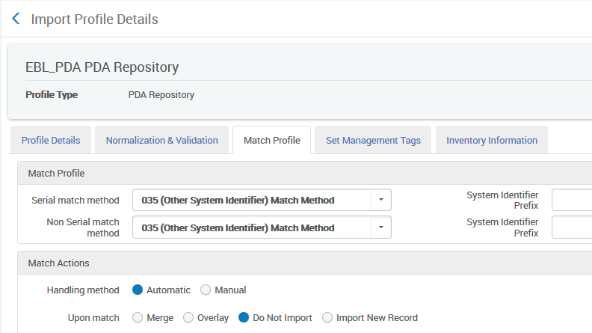

Manage PDA Profiles - Repository
We also state in this import profile of type ‘PDA Repository’ that
If the record already exists (based on the 035 field) then do not import the new one and do not overlay or merge the existing.
If the record does not already exist then import it

Slide 18
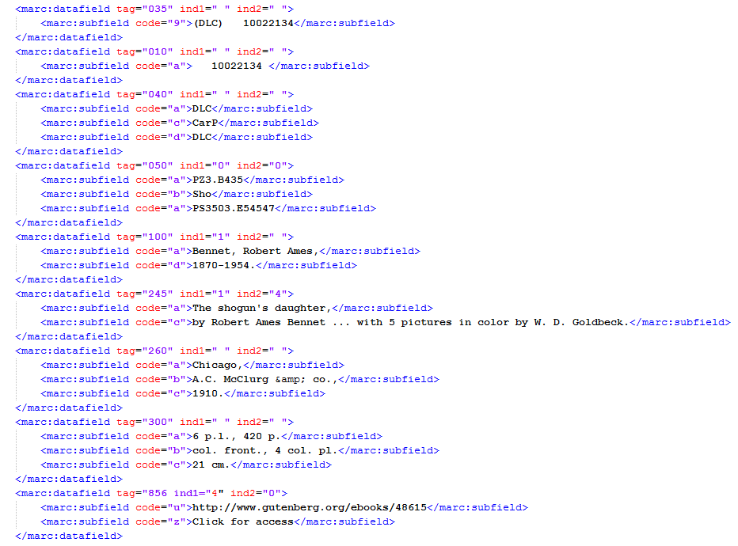
Manage PDA Profiles - Repository
The first of two records in the file which we will upload. Title “The shogun’s daughter”.
Active portfolio will be created from this URL

Slide 19
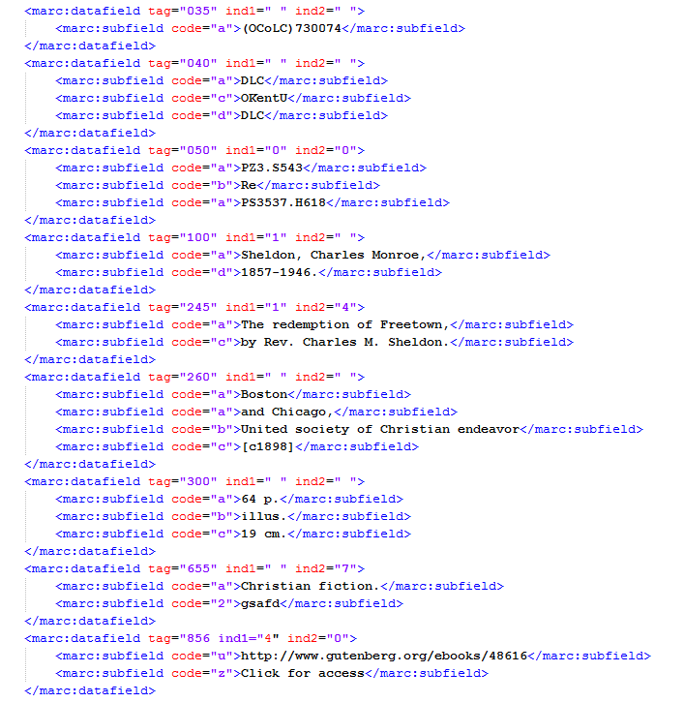
Manage PDA Profiles - Repository
The second of two records in the file which we will upload. Title “The redemption of Freetown”.
Active portfolio will be created from this URL

Slide 20
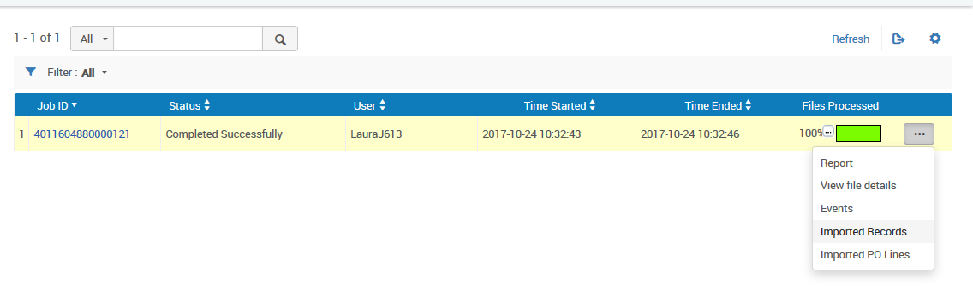
Manage PDA Profiles - Repository
The import job runs and completes and we view the uploaded records

Slide 21
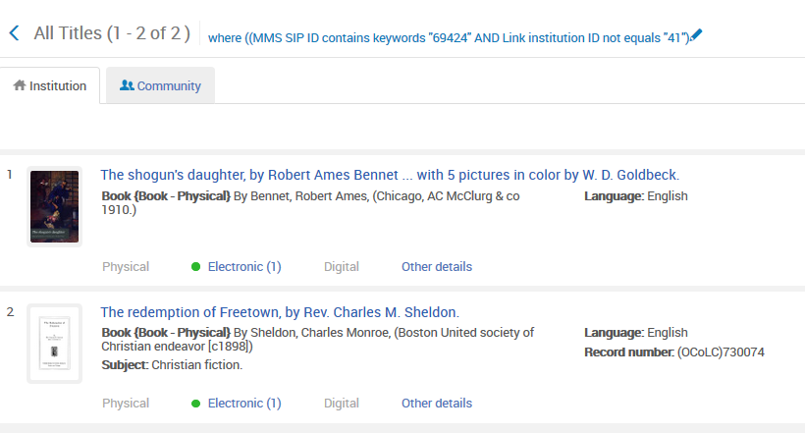
Manage PDA Profiles - Repository
Here are the imported records which are part of the PDA profile.
They will be published to Primo (as is stated in the PDA import profile).

Slide 22
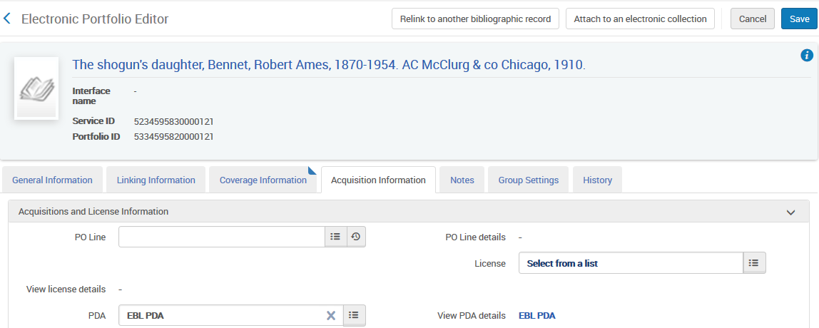
Manage PDA Profiles - Repository
The portfolio editor shows a link to the PDA profile

Slide 23
Agenda
Introduction and overview
Create a new PDA entry
Manage PDA Profiles - Repository
Manage PDA Profiles - New Order
Remove non-ordered records

Slide 24
Manage PDA Profiles - New Order
Now we will assume that both records were published to primo.
Title “The redemption of Freetown” was clicked more than 3 times (3 is the “Access Threshold” defined in the PDA profile) and should therefore be ordered
Title “The shogun’s daughter” was not clicked at all and should thus be removed

Slide 25
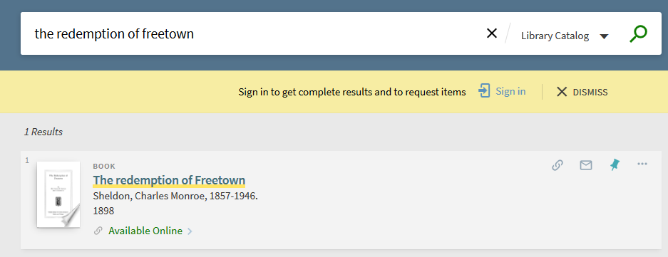
Manage PDA Profiles - New Order

Slide 26
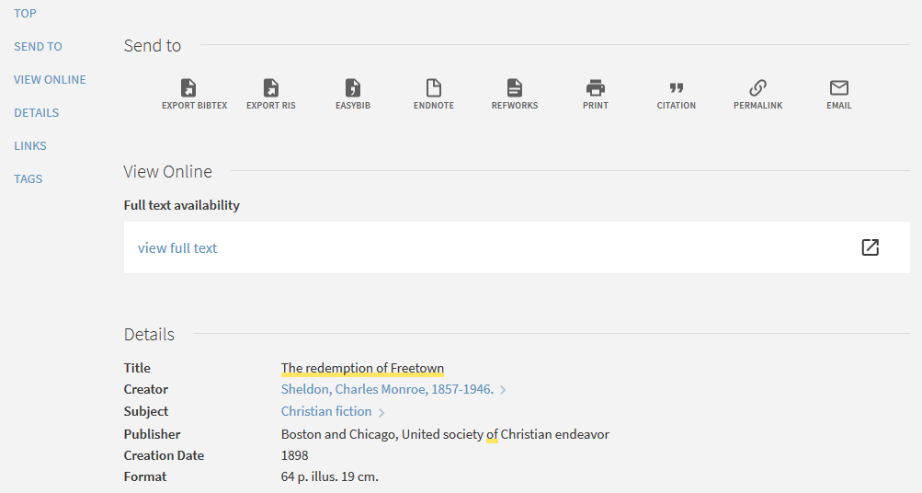
Manage PDA Profiles - New Order

Slide 27
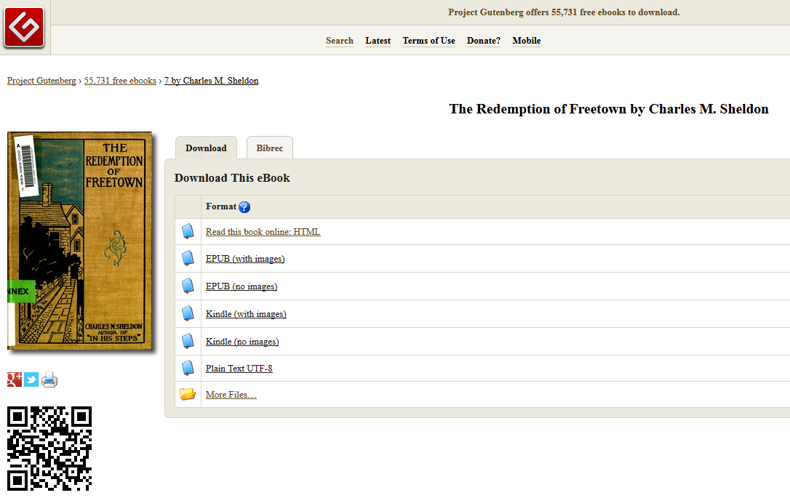
Manage PDA Profiles - New Order

Slide 28
Manage PDA Profiles - New Order
The vendor then sends the library an EOD file for the order of “The redemption of Freetown”, and it will be imported via the PDA profile of type “New order”

Slide 29
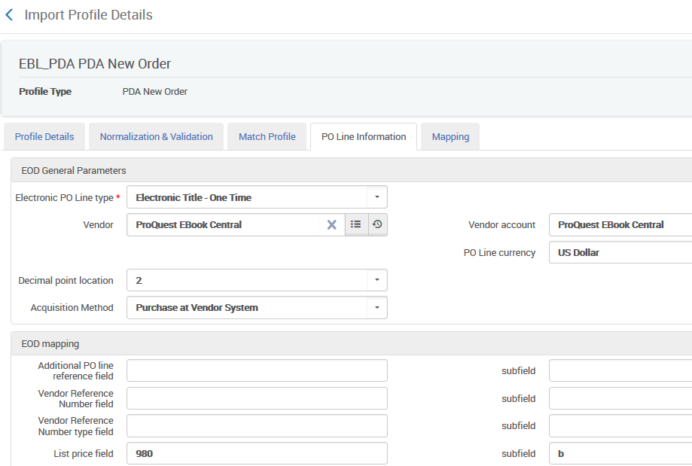
Manage PDA Profiles - New Order
Here is the PO Line Information tab of the “New Order” profile

Slide 30


Manage PDA Profiles - New Order
Here is the order xml file
The profile defined that the match will be on the 035 (for overlay)
The profile defined that the price will come from 980 $$b

Slide 31
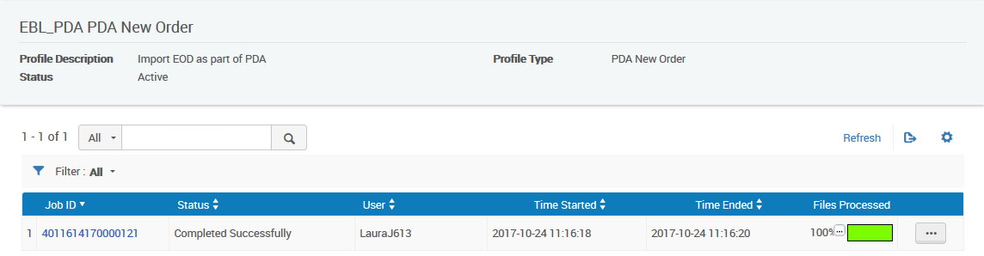
Manage PDA Profiles - New Order
The import for the PDA new order import profile completes

Slide 32
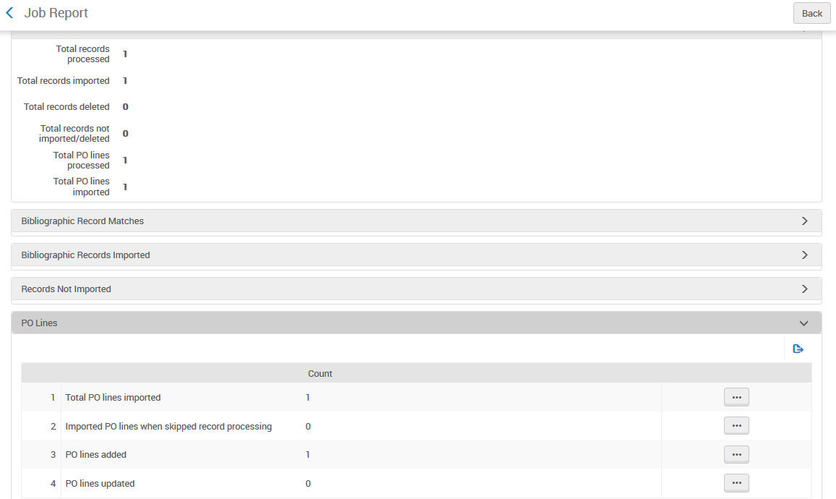
Manage PDA Profiles - New Order
One POL is created

Slide 33
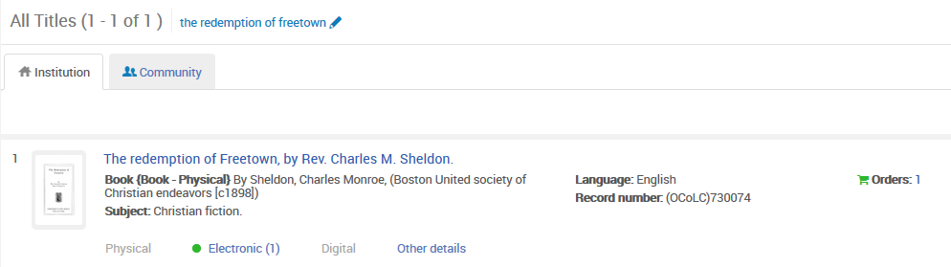
Manage PDA Profiles - New Order
Now the portfolio has an order

Slide 34
Agenda
Introduction and overview
Create a new PDA entry
Manage PDA Profiles - Repository
Manage PDA Profiles - New Order
Remove non-ordered records

Slide 35
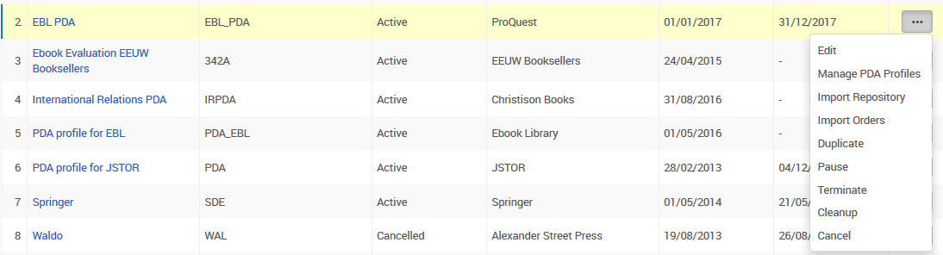
Remove non-ordered records
Now we need to remove all non-ordered records
We have records in the system which no one ever clicked (or they were clicked less than the access threshold) and never got ordered
They must be removed. This is done via “Cleanup”

Slide 36
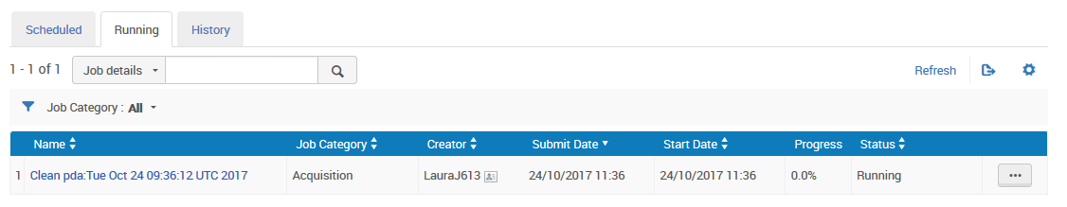
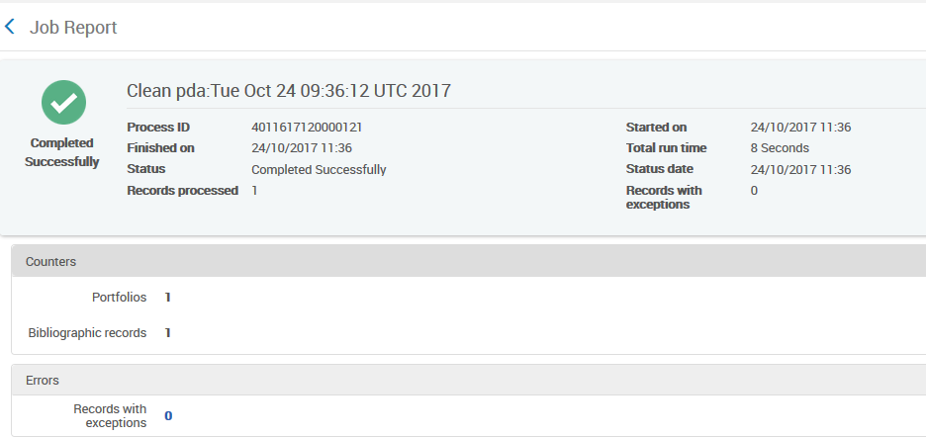
Remove non-ordered records
It sends a “Clean-Up” job
One bibliographic record and one portfolio deleted. This is the record received from the vendor but never ordered (The shogun’s daughter)

Slide 37
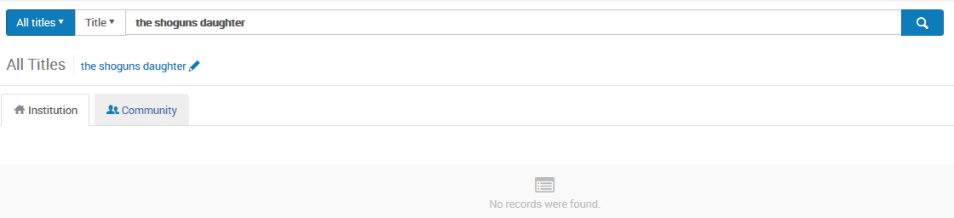
Remove non-ordered records
The record which was never ordered is gone (cleanup has occurred in the repository)

